Slide 1
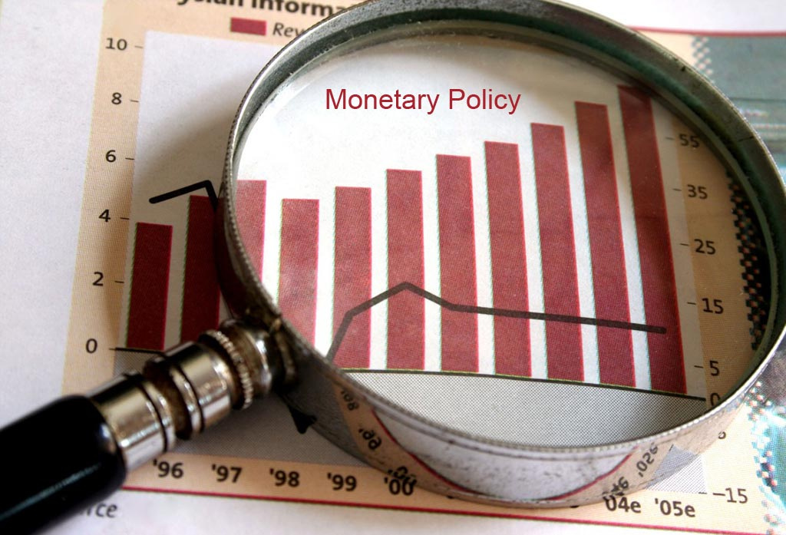
`

Slide 2
Learning Outcomes:
To understand the meaning and scope of monetary policy;
To understand the various instruments of monetary policy;
To analyze the role of monetary policy in achieving macroeconomic goals;
To discucss the effectiveness and limitations of monetary policy.

Slide 3
“Monetary policy refers to the action taken by the monetary authorities to control and regulate the demand for and supply of money with a given purpose.”

Slide 4

Objectives of Monetary Policy

Slide 5
Scope of Monetary Policy:
The scope of monetary policy depends, by and large, on two factors:
The level of monetization of the economy, and
The level of development of the financial market

Slide 6
INSTRUMENTS OF MONETARY POLICY
General Credit Control Measures
Bank Rate
CRR
Open Market Operations
SLR
Repo Rate (Repurchase operation rate)
Reverse Repo Rate
Selective Credit Control Measures
Credit Rationing
Change in Lending Margin
Moral Suasion

Slide 7
Bank Rate Policy
The RBI Act 1935 defines ‘bank rate’ as the “standard rate at which (the bank) is prepared to buy or rediscount bills of exchange or other commercial papers eligible for purchase under this Act.”
The central bank can change this rate—increase or decrease—depending on whether it wants to expand or reduce the flow of credit from the commercial banks.
This policy action by the central bank is called the bank rate policy.

Slide 8
Limitations of Bank Rate as a Weapon of Credit Control
The variation in the discount rate works effectively only when commercial banks have no alternative to borrowing from the central bank.
With the growth of credit institutions and financial intermediaries, the capital market has widened extensively and the share of banking credit has declined.
Looking from the credit demand angle, variations in the discount rate work effectively only where demand for credit is interest-elastic.

Slide 9
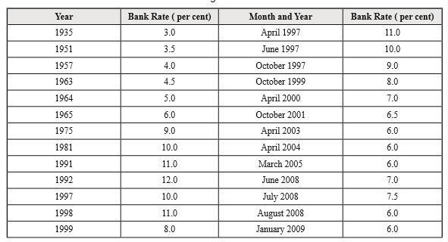
Changes in Bank Rate in India

Slide 10
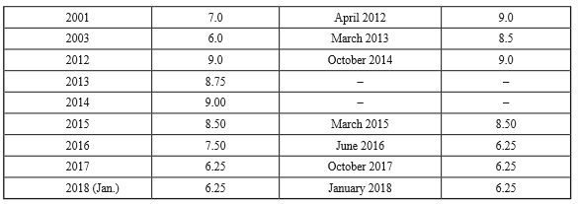
Changes in Bank Rate in India

Slide 11
In order to control inflation what RBI will ?
Will increase bank rate
Will decrease bank rate

Slide 12
Cash Reserve Ratio (CRR)
The ‘cash reserve ratio’ (CRR), known also as ‘statutory reserve ratio (SRR), is the percentage of total deposits which commercial banks are required to maintain in the form of cash reserve with the central bank.
The central bank enjoys the legal powers to change the cash reserve ratio of the banks.
When economic conditions demand a contractionary monetary policy, the central bank raises the CRR and when economic conditions demand monetary expansion, the central bank cuts down the CRR.

Slide 13
In order to control inflation what RBI will ?
Will increase CRR
Will decrease CRR

Slide 14
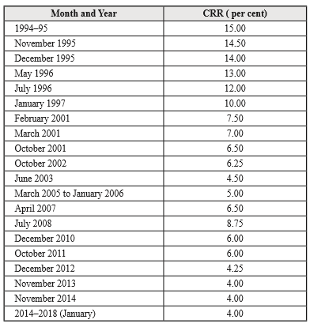
Changes made in CRR

Slide 15
Open Market Operations
The ‘open market operation’ is the sale and purchase of government securities and Treasury Bills by the central bank of the country.
The sale of government bonds and securities affects both the supply of and demand for credit—supply of credit by affecting the credit creation capacity of the banks and demand for credit by changing the rate of interest.

Slide 16

TIME FOR QUIZ

Slide 17
What is meant by monetary policy?
What monetary measures have been used by the RBI to control inflation in the country?
How does the working of OMO affect the money supply in a country like India?

Slide 18

Statutory Liquidity Ratio (SLR)
Under the SLR scheme, the commercial banks are required by statute to maintain a certain percentage of their total daily demand and time deposits in the form of liquid assets.
The method of determining the SLR,
The basic purpose of using SLR was to prevent the commercial banks from going for liquidating their assets when CRR was raised to control money supply.

Slide 19
The Repo Rate: A New Monetary Tool
Under the repo system, the RBI buys securities back from the banks and, thereby provides funds to the banks. It is a form of lending money to the banks for a short period 1–14 days.
The rate of interest at which the RBI lends money to the bank is the repo rate. In contrast, there is reverse repo rate.
The reverse repo rate is the rate at which the banks can buy the securities or deposit money with the RBI.
When the central bank aims at increasing liquidity or money supply, it buys back the securities at a low repo rate and vice-versa.

